Slide 1
Regional Stakeholder Event on Horizon Europe Implementation
Ex-ante and ex-post controls:
From H2020 to Horizon Europe
Romania and Bulgaria,
Ruse, 22 January 2020
#HorizonEU
Common Audit Service
Sorin Serban

Slide 2
Agenda
1. Introduction on Controls
2. Experience from Horizon2020
3. Horizon Europe: Systems and Processes Audit and Cross reliance
4. Horizon Europe: Public Consultation
5. Way Forward – Audits in Horizon Europe

Slide 3
1. Ex-ante controls
• Authorising Officers (AODs) must put in place internal control systems suited to the performance of their functions;
• AODs must ensure equal treatment for all
Beneficiaries;
• The control system shall ensure an appropriate balance between trust and control and must be cost effective;
• Controls must be developed with due consideration to the programme objectives and taking into account the associated costs for all stakeholders.

Slide 4
1. Ex-ante controls
PRINCIPLES
Balance between trust and control
METHODOLOGY
Limited information requested ex-ante (Financial statements, use of resources)
Minimize burden on beneficiaries
Equal treatment
Risk considerations may justify asking the beneficiary for further information and/or evidence

Slide 5
1. Ex-post controls in H2020 – The design
More Simplification
      25% flat rate for indirect costs
      One set of documents : MGA and annotated
      A governance to increase synergies
        The creation of the Common Audit Service for all H2020 ex-post audits
        One Horizon 2020 (Corporate) Audit Strategy
More Transparency
      Annotated Model Grant Agreement containing Examples, best practices, Lists and procedures , Specific cases and exceptions
      Research Enquiry Service & FAQ
      Online Indicative Audit Programme (regularly updated)

Slide 6
DG Declaration
of Assurance
Why do we need an audit?
I, the undersigned Director-General, declare that the information contained
in this report gives a true and fair view [1].
I state that I have reasonable assurance […] which is based on my own judgement and on the information at my disposal […]
However the following reservation should be noted:
Brussels, 31 March 20XX
"Signed"
The Director-General
[1]True and fair in this context means a reliable, complete and correct view on the state of affairs in the service.
Reservation concerning the rate of residual errors with regard to the accuracy of financial statements in the Framework Programme
Notes:
Fundamental on the budgetary Discharge process

Slide 7
Errors. Why do they occur?
Misunderstandings of the rules;
Lack of attention to the detail of the provisions of the grant agreements.

Slide 8

The consequences of errors:
Beneficiaries
Non-optimal use of funding available
Recoveries
European Commission
Scrutiny of the Budgetary Authority and ECA
Increased error rate
Increased ex post audit efforts
Corrective measures

Slide 9
Audit Cycle
Planning
Execution
Reporting
Strategy
9

Slide 10
Audit Planning
Selection of
beneficiaries
In-house:
mission planning
Externalised:
batch preparation
10
10
10
Notes:
10

Slide 11
Error Rate
Population
€
Sample
€
€
∑ neg_adj
€
Error Rate % =
€
∑ aud_amount

Slide 12
2. Audit in H2020 – Main detected errors (1/2)
Personnel costs – due to:
Incorrect productive hours calculation
Incorrect remuneration costs - e.g. estimated
Incorrect time working on action claimed
Other - e.g. unreliable/missing timesheets
Subcontracting - due to:
Lack of adequate supporting documents
Not foreseen in Annex I nor agreed by EU services
Other errors – including e.g. no value for money

Slide 13
2. Audit in H2020 – Main detected errors (2/2)
Other goods and services - due to:
Lack of adequate supporting documents
Cost not related to the action
No direct measurement of the cost
Other errors – e.g. indirect costs claimed as direct costs, no value for money
Travel - due to:
Cost not related to the action
Other errors – e.g. lack of adequate supporting documents

Slide 14
2. Ex-post controls in H2020 – The Feedback
Main feedback from Audited Beneficiaries
      Beneficiaries welcome audits conducted centrally by the Common Audit Service.
      Preparatory files in H2020 ex-post audits can be time consuming.
      Certificate on Financial Statements (CFS): external auditors may not have the specialized knowledge needed for H2020 projects.
      The calculation of personnel costs can be complex and time consuming.
      Disproportionate audit effort on costs categories with low participation in the overall budget (e.g. travel costs and subsistence).
      LRI & CoMUC: too long procedures.

Slide 15
3. Horizon Europe: the novelties in audit
Systems and Processes Audit (SPA)
Wider cross-reliance on audits and assessments

Slide 16
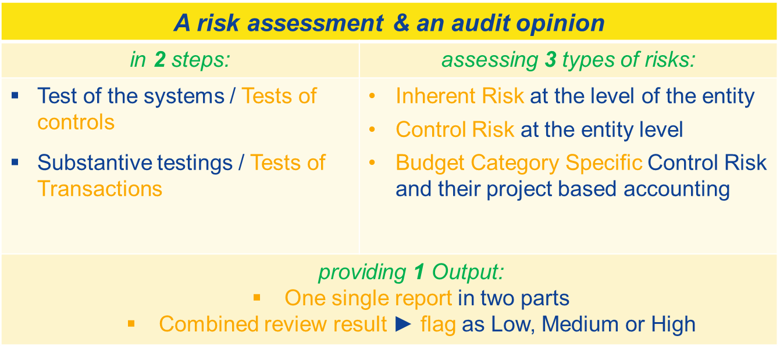
3.System and Process Audit (1/2)
What is a SPA ?

Slide 17
3. System and Process audit (2/2)
Objectives
- Reduced administrative burden;
- Less but more focused audits;
- Reliance on the internal control system of the beneficiary (prevent and detect errors)
Consequences
- Timing of the SPA (with first audit)
- Future audits after SPA (less intensive audits, less intensive CFS)

Slide 18
3. Cross reliance(1/2)
  Simplified audit and control system:
NEW
Key features
  Combined reviews
  Single audit principle for joint funding
  Possibility for enhanced cross-reliance
Combined review
Combines systems and process audit with an audit of transactions
Optional for certain types of beneficiaries
May lead to less Certificates on Financial Statements
Single audit principle for joint funding
A single audit for actions that receive joint funding from different Union programmes
Possibility for enhanced cross-reliance
Possibility for the Commission to rely on audits on the use of Union contributions carried out by other persons or entities
Reduced audit burden for beneficiaries

Slide 19
3. Cross reliance(2/2)
Factors of success
Having "conditions equivalent" between EU programmes irrespectively of the management mode,
Enhancement of corporate IT tools:
Taking into account international benchmarks:
  International Standard on Auditing (ISA)
  INTOSAI
  COSO

Slide 20
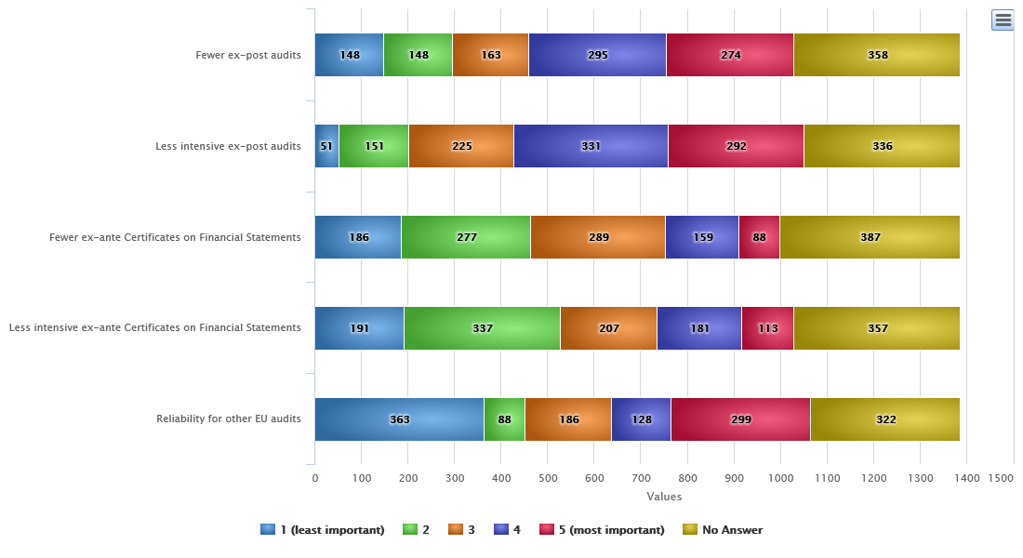
4. Results of consultation – Control Strategy (3/3)
What type of benefits would you expect from a Systems and Processes Audit (SPA)? (rank by order of preference)
The replies are mitigated among the five types of impacts of a SPA and what is predominant is that a SPA should bring fewer ex-post audits and less intensive audits. For Romania and Bulgaria the situation is very similar.

Slide 21
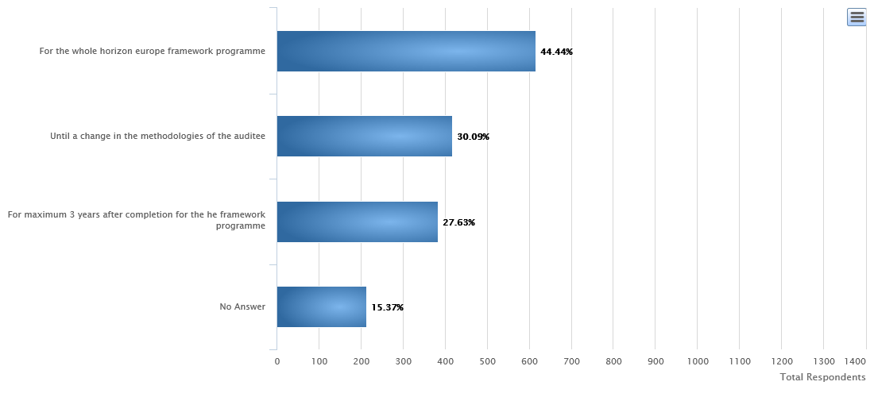
4. Results of consultation – Control Strategy (2/3)
The Systems and Process Audits (SPA) should be valid...
The validity of the SPA’s should be for the whole framework programme and for maximum 3 years or until a change in the metodologies for ¼ of the other replies. For Bulgaria and Romania the majority of respondents prefer also for maximum three years.

Slide 22
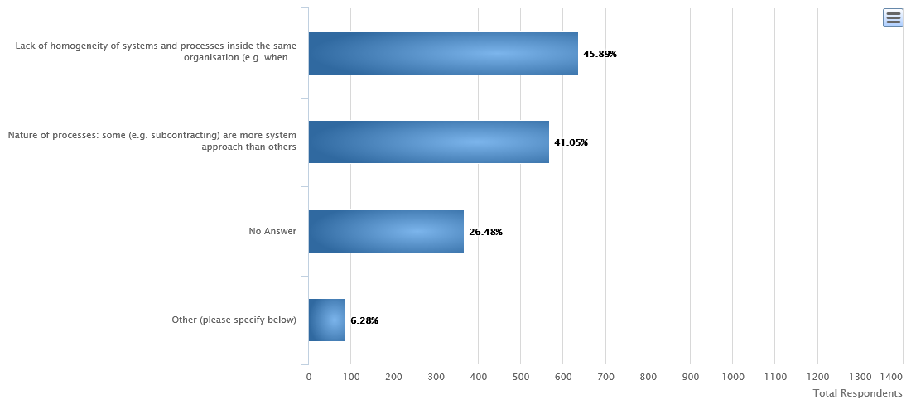
4. Results of the public consultation – Control Strategy (3/3)
Main respondents pointed out the lack of homogeneity of systems and processes and their nature as being a limitation for a SPA for around 86% of the replies. For Bulgaria and Romania the main limitation seem to be the nature of processes.
What are the limitations to a SPA?

Slide 23
5. Way Forward – Audits in Horizon Europe
Pilot System and Process Audit on a number of beneficiaries
Further consultation with beneficiaries and member states
Discussion with the Central Services of the Commission regarding further simplification
Discussion with Services of the Commission responsible for shared management
Launch of the Horizon Europe audit campaign (creation of an audit strategy)

Slide 24
Thank you
for your
attention & participation !

